Slide 1
Architecture point of view Medicare on Next Gen Platform
Key Strategic Program: Medicare Next Generation Platform May 2018

Slide 2
Architectural Overview: Medicare Next Gen Platform
North
Star
Topline
Guardrails
- Next Gen is a multi-line of business platform: consider decisions & implementation consistent with sharing resources allows for shared costs driving down PMPM.
Improve Health Care constituent experiences through digitally driven care-based actions balanced with a cost-effective platform that drives a better return on investment for the Medicare line of business.
- Eliminate redundancy of two operating platforms
Consolidate Medicare operations onto the Next Gen Platform in order to achieve a lower cost as measured by PMPM while retiring the higher cost legacy operations platforms of aetna and Coventry Health.
Utilize aetna enterprise in the ecosystem platform investment in service customer care and care management
- Utilize selected vendor offerings as intended – minimize aetna unique changes and only when appropriate, determine customization level as a part of the decision process.

Slide 3
North Stars: four at work when we consider Group
Plan Sponsor
Medicare
Plan Sponsors are a valued constituent shall be engaged in a aetna digitally transformed experience consistently across commercial and retiree populations
Consolidate Medicare operations onto the NGP to achieve a lower cost as measured by PMPM
Improve Health Care constituent experiences: Utilize aetna enterprise ecosystem digital platform investments in service, customer care and care management management
Plan
Next Gen Platform
Plan description & specification is tightly coupled to each intended use and support purpose for the intended constituent or task (contact center, quoting & rating, benefit administration)
Next Gen is a multi-line of business platform: consider decisions & implement consistent with sharing resources, shared costs drive down PMPM.
Utilize selected vendor offerings as intended – minimize aetna unique changes and only when appropriate ….

Slide 4
Architectural Overview: Medicare Next Gen Platform
NextGen Platform NorthStar
Plan Sponsor
Topline
Guardrail
Plan Sponsor
Consistent PS experience via Enterprise systems of record especially a consolidated aetna bill e.g. PSBoR, PSIL
Plan Sponsors are a valued constituent shall be engaged in a aetna digitally transformed experience consistently across commercial and retiree populations.
Consistent PS Administrator experience via the constituent systems of engagement
Consistent PS experience via Enterprise systems of insight especially those delivering PS reporting eg ART/DART
Strive to assist the employee to retiree transition in selection of Same-or-Better coverage plans.
Notes:
Commentary: the introduction of Group: Plan Sponsor offerings introduces several major considerations especially in the area of adding the constituent: Plan Sponsors and their administrators; Product Offerings; and the business processes which support them.

Slide 5
Group: Medicare NGP Guiderails
Topline
Guiderails
Assist the employee in transition to retiree in the selection of Same-or-Better coverage Medicare plans.
Be able to answer:
Which members belong to which Plan Sponsor
Which members belong to which Plan
Which Plans are used to support which Plan Sponsor
Plan Sponsor uses which Products
Will be able to Report both standard and custom
Data integration will flow on the EIE
PS Case sales, setup, installation Process shall be monitored, modeled, event notification and managed.
Member enrolment by Plan Sponsor

Slide 6
Architectural Overview: Medicare Next Gen Platform
Plan/Offering
Current
State
Guardrails
Group Plans
Medicare NGP
Plan description & specification is tightly coupled to each intended use and support purpose for the intended constituent or task (contact center, regulatory filing; quoting & rating; claims administration)
Language of Benefit/Plan is to be appropriate to the intent
Axiom: no ‘Plan’ has nor ever will (5 years) serve all Plan/Offering Use Cases from one source.
Q: What Digital Transformation or Innovation could challenge this Axiom?
Natural Language for human use: sales, support;
Application context for automated administration.
Plan/Offering Index: each representation of a Plan instance shall be indexed, allows for link or traceable association. (Analogy Global ID for each Plan)
Axiom: for Product there is no BoR only Source of Reference by usage ? (Prove a negative?)

Slide 7
Group: Medicare NGP Guiderails Key architectural policy and principles apply …
Policy as
Guiderails
Leverage Ecosystem Platform capabilities where at all possible as part of ensuring a seamless constituent experience across the total Aetna ecosystem (PS & Consumer)
Align choice of data source (when multiple options) with Source of Record and Source of Truth designations where such exist
All cross-domain (incl. to 3rd party platforms) real time integrations must go through a managed API
Ensure that enterprise needs are taken into account in solution and integration designs for enterprise components; known requirements will be provided by the EA teams and engaged business owners
The Architecture Planning team adjudicates what constitutes an Enterprise Component, based on current Enterprise Blueprints as well as known requirements from programs across all of Aetna
Link to the full Architecture Policies document
Enterprise Architecture Principles are here

Slide 8
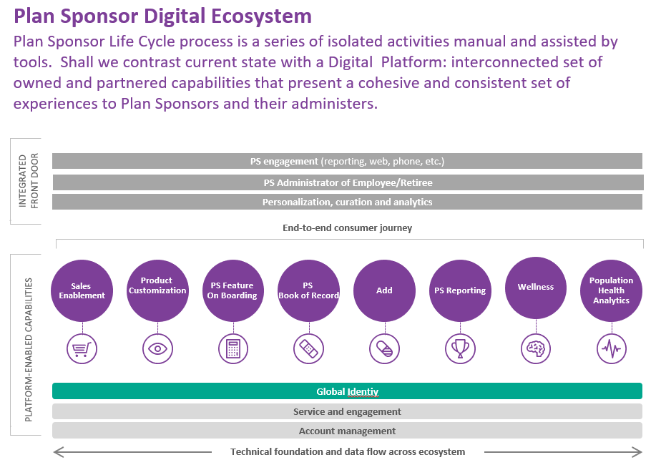
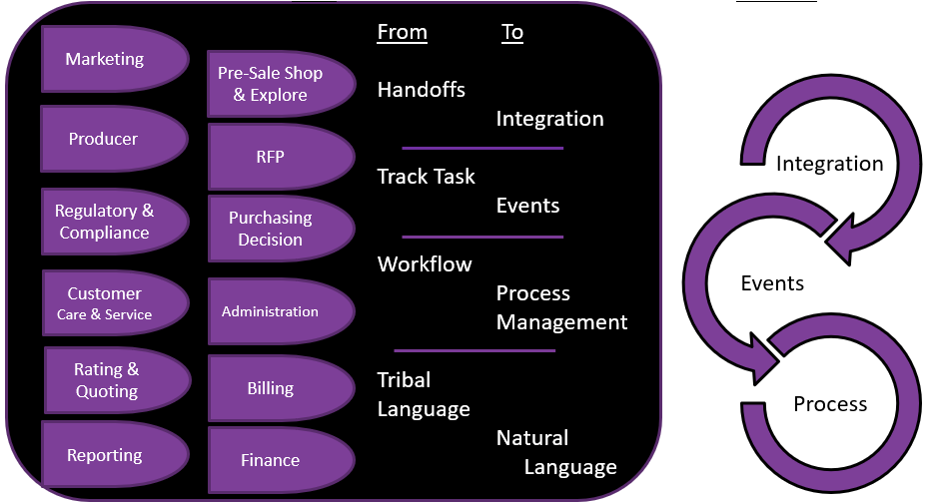
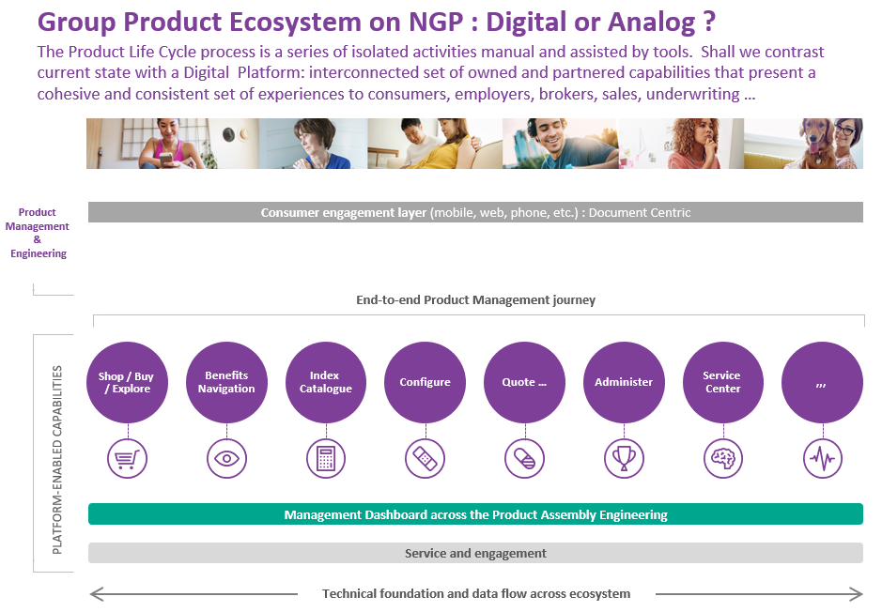
Two Epiphanies for the Advent of Group Medicare on Next Generation Platform
Plan Sponsor organization
Organization construct
Constituent expands to include PS Admin
New type of interaction with Producers
PS Reporting
Plans: Group PS Product & Offerings

Slide 9
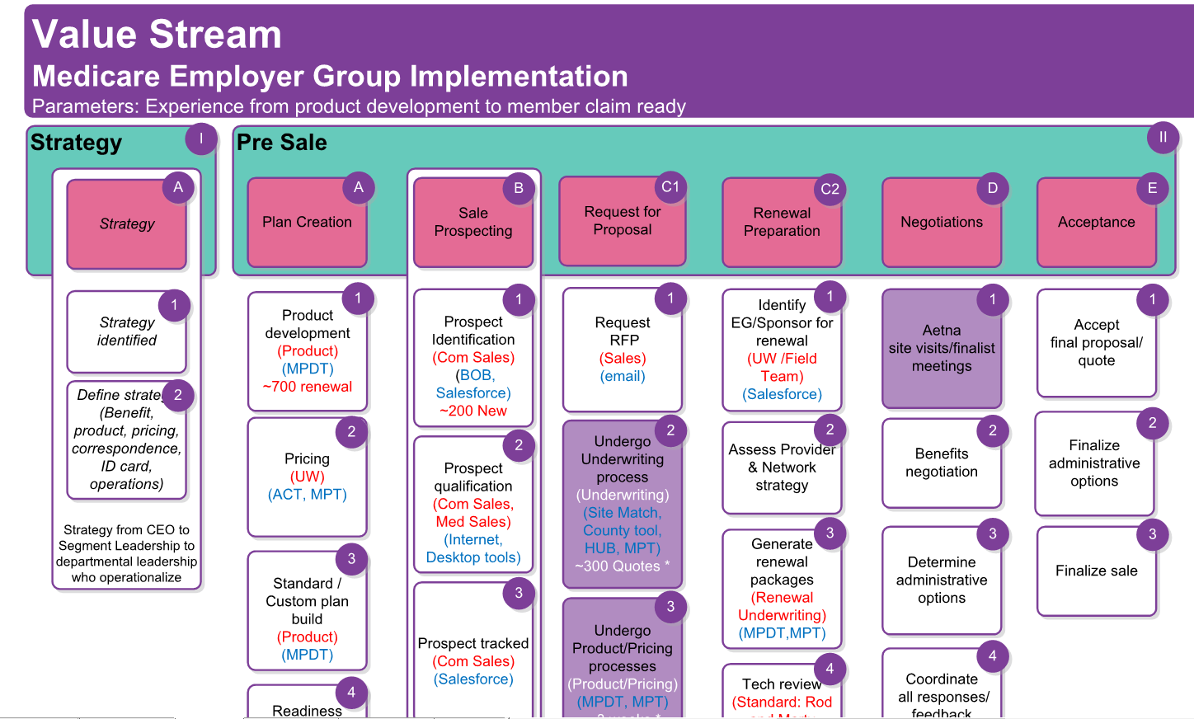
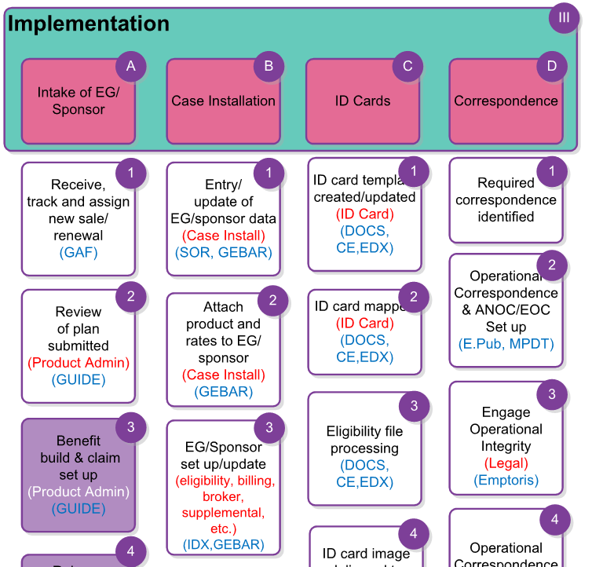
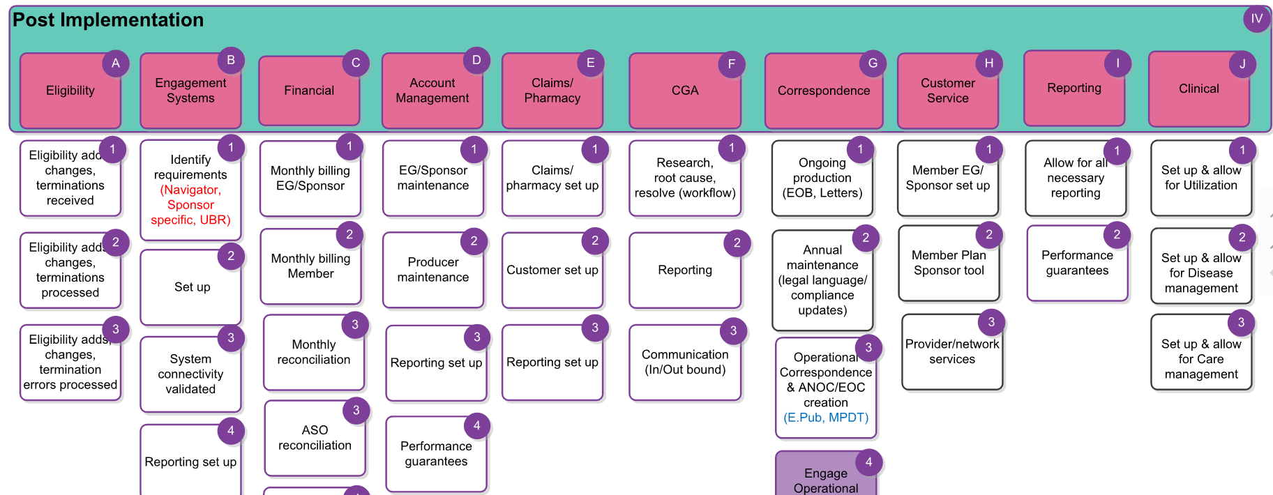
Value stream analysis lead by
Medicare Program Management business unit.

Slide 10
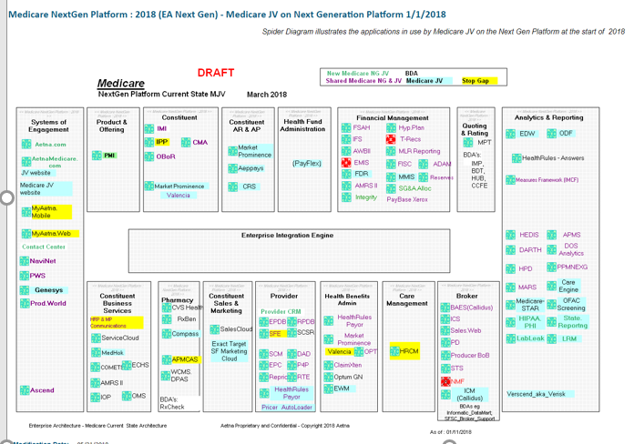
MNG : Spider Diagrams: Medicare JV 1/1/2018
http://aetnet.aetna.com/technet/nearwip/pages/10da1cab5a1f4113.htm

Slide 11
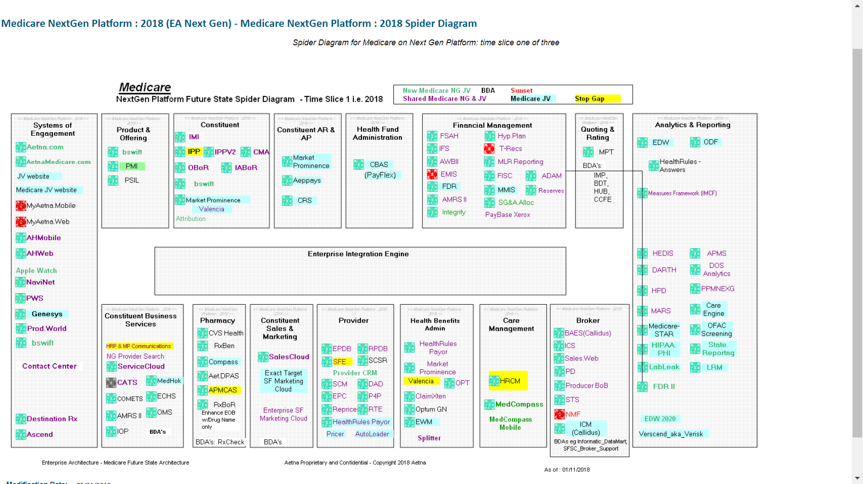
MNG : Spider Diagrams: Medicare AEP Fall 2018
http://aetnet.aetna.com/technet/nearwip/pages/10da1cab5a1f4113.htm

